Slide 1
Airline delay Analysis
Saikiran kancharla
Ragu Subbaian

Slide 2
Overview of data And Methodology
Collected Flight delay data from December 2017 – November 2018 from Bureau of Transportation Statistics
Size of 2.4GB with 7M observations and 97 variables
Appended month by month data to create a master file
Utilized Neo4J and Databricks pyspark for Data Analysis

Slide 3
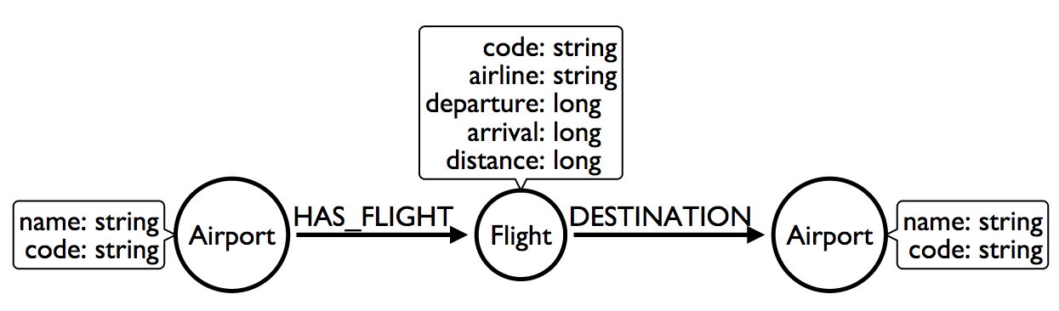
Data Model for Neo4j
In order to explicitly relate properties of a flight ,Used the data model shown in the figure.
Data Import
docker run \ --publish=7474:7474 --publish=7687:7687 \ --volume=/Users/saikiranreddy/neo4j/import:/var/lib/neo4j/import \ --volume=/Users/saikiranreddy/neo4j/data:/var/lib/neo4j/data \ --volume=/Users/saikiranreddy/neo4j/plugins:/var/lib/neo4j/plugins \
test
Mapped Local Volume to Docker Volume
Staged Data in the import folder of neo4j
Used Cypher to import data

Slide 4
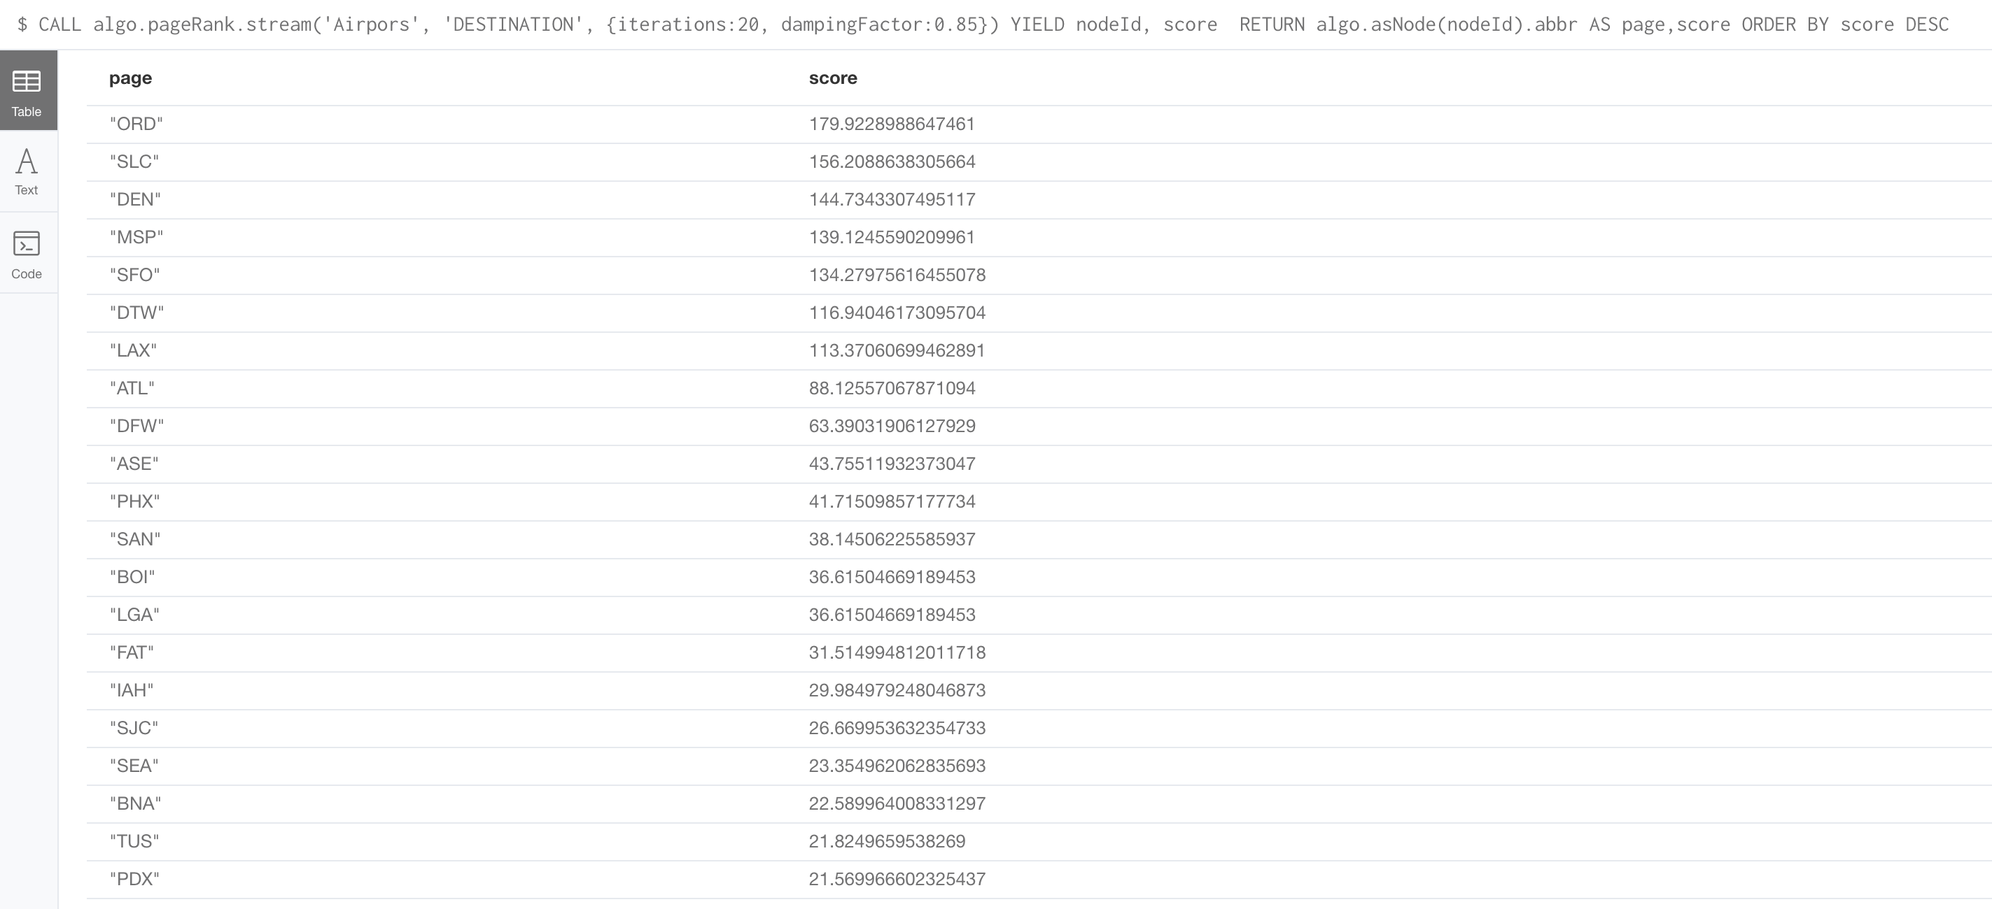
Popular Origin and Destination Airports
Used neo4j plugins to import neo4j inbuilt graph algorithams.
Determined popular origin/Destination Airports using Page Rank algorithm

Slide 5
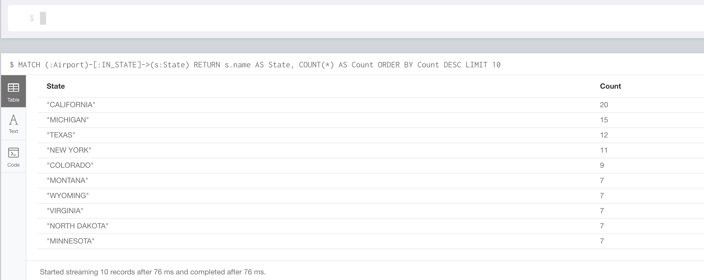
Most Number of Airports by State

Slide 6
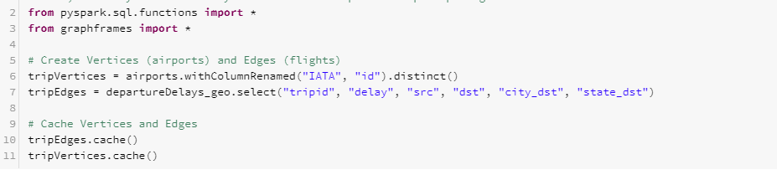
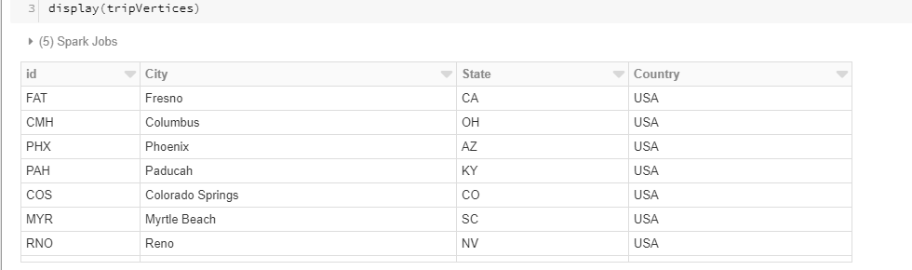
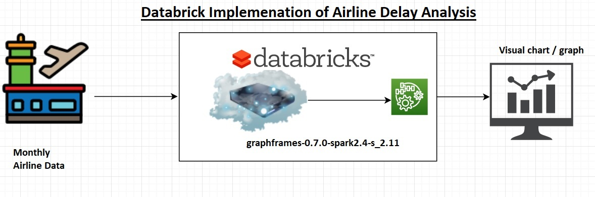
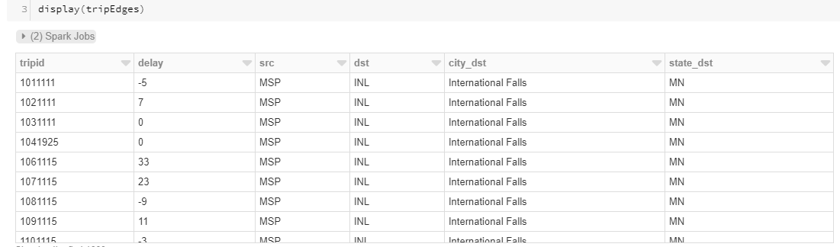
Analysis using Databricks
Used two files to create graph using graphframes
Airport codes Dataset as Vertices
Departure delays Dataset as Edges
Columns names are changed to map nodes and
vertices

Slide 7
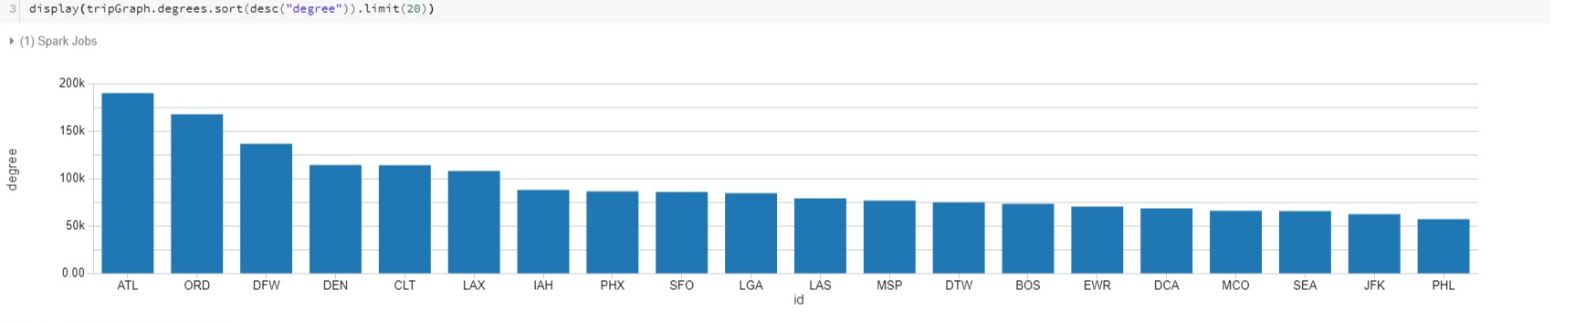
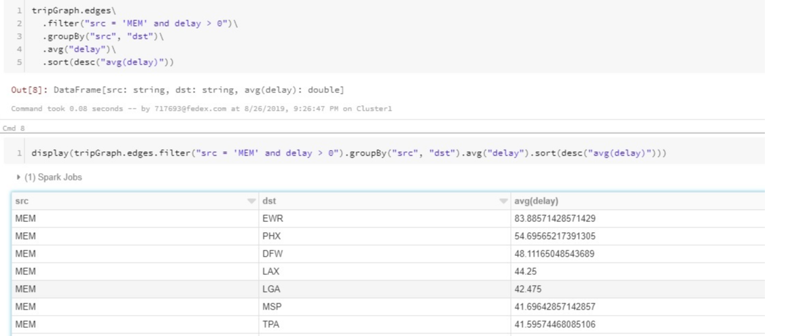
Busiest Airports
Memphis Airport Delays

Slide 8
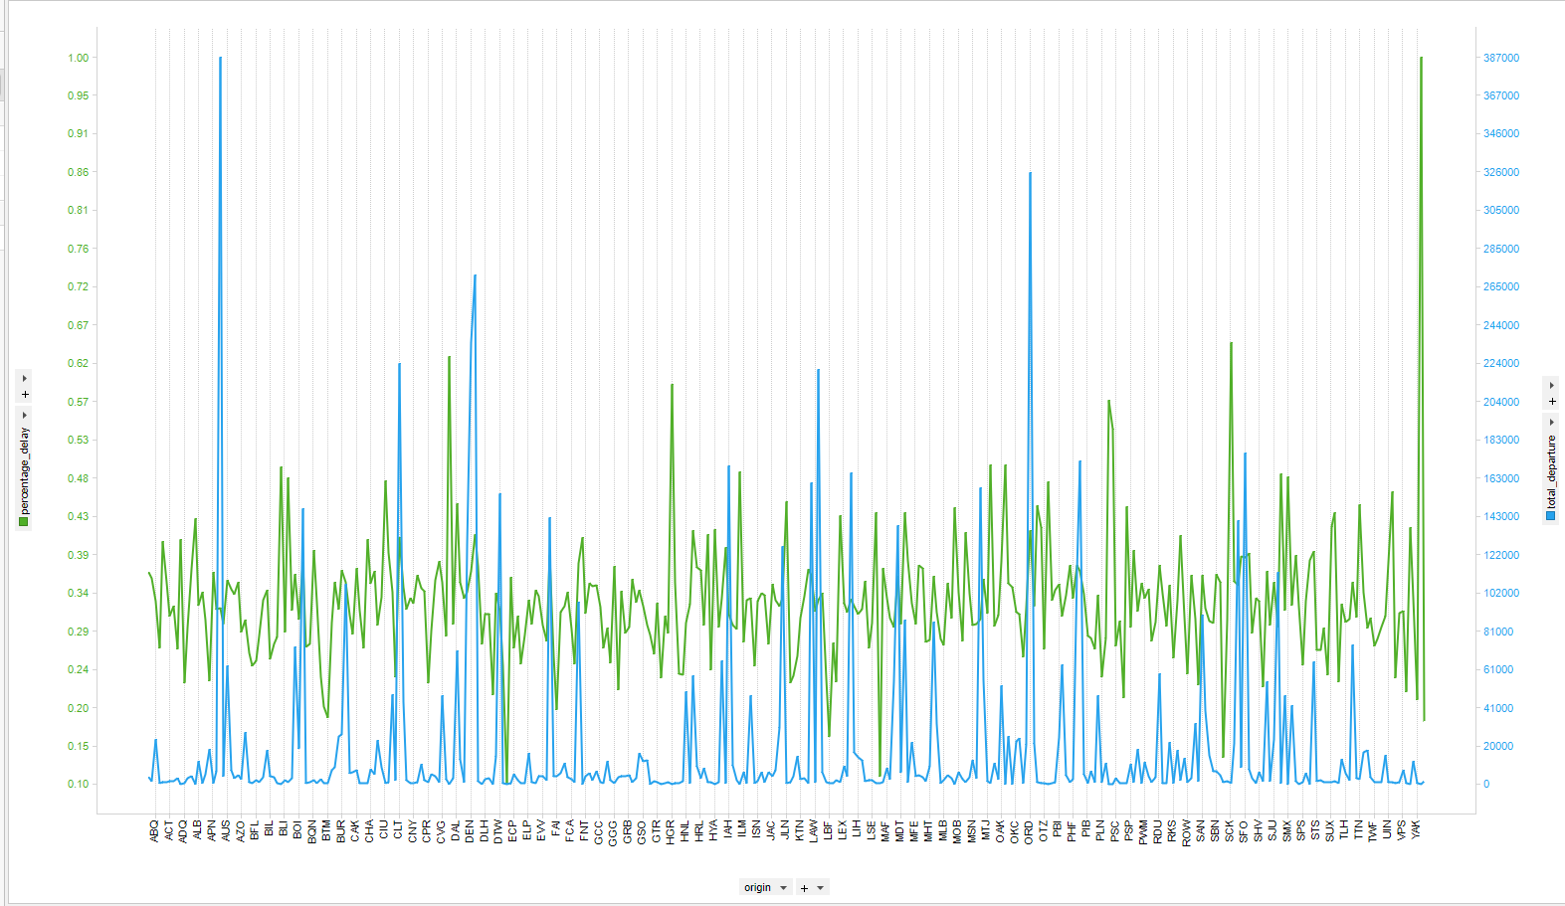
Impact of crowded airspace on delays
Regional airports has high percentage delays than Major international airports
Correlation between total departures and percentage delay is 0.11
Airports with high percentage delays have relatively low crowded airspace

Slide 9
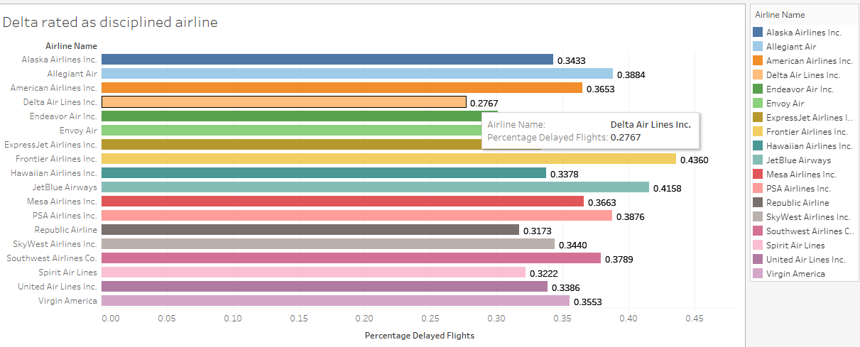
Disciplined Airline

